Slide 1
Chapter 7
Navigation Menus

Slide 2
Objectives
Applied
Use unordered lists and <a> elements to create navigation lists and navigation menus, including 2- and 3-tier menus.
Knowledge
Name and describe the three types of HTML lists.
Describe the use of <a> elements for linking to another web page, opening another web page in a new browser window, linking to placeholders on the same page, linking to media files, starting an email message, calling a phone number, or starting a Skype session.
Use these pseudo-classes for formatting links: :link, :visited, :hover, and :focus.
Use these CSS properties for formatting links: text-decoration or border.

Slide 3
Lists
<ul>, <ol>, <dl> tags

Slide 4
HTML for an unordered list with paragraphs and links
<h1>San Joaquin Valley Town Hall Programs</h1>
<ul>
<li>
<p>Join us for a complimentary coffee hour at the
<a href="saroyan.html">William Saroyan Theatre</a>, 9:15 to 10:15
a.m. on the day of each lecture. The speakers usually attend this very special event.</p>
</li>
<li>
<p>Extend the excitement of Town Hall by purchasing tickets to the post-lecture luncheons. This unique opportunity allows you to ask
more questions of the speakers--plus spend extra time meeting new Town Hall friends.</p>
<p>A limited number of tickets are available. Call (559) 555-1212 for reservations by the Friday preceding the event.</p>
</li>
</ul>

Slide 5
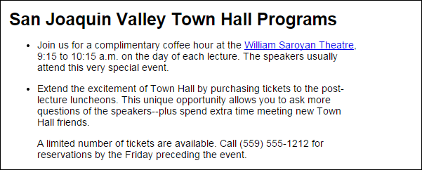
The unordered list in a web browser

Slide 6
An ordered list that is continued
<h1>How to use the WinZip Self Extractor</h1>
<h2>Before you start the WinZip Self Extractor</h2>
<ol>
<li>Create a text file that contains the message you want to be displayed when the executable starts.</li>
<li>Create a batch file that copies the exercises, and store it in the main folder for the files to be zipped.</li>
<li>Create the zip file.</li>
</ol>
<h2>How to create an executable file</h2>
<ol start="4">
<li>Run the WinZip Self Extractor program and click through the first three dialog boxes.</li>
<li>Enter the name of the zip file in the fourth dialog box.</li>
<li>Click the Next button to test the executable.</li>
</ol>

Slide 7
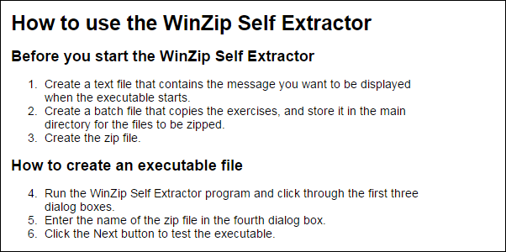
The ordered list in a web browser

Slide 8
Nested Lists
<h1>How to use the WinZip Self Extractor program</h1>
<ul>
<li>Before you start the WinZip Self Extractor
<ol>
<li>...</li>
<li>...</li>
<li>...li>
</ol>
</li>
<li>How to create an executable file
<ol start="4">
<li>...li>
<li>...</li>
<li>...li>
</ol>
</li>
</ul>

Slide 9
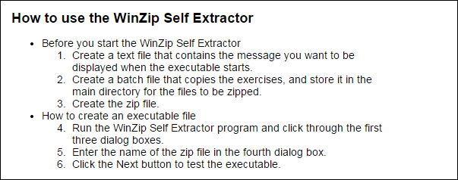
The nested lists in a web browser

Slide 10
HTML for a description list
<h2>Components of the Internet architecture</h2>
<dl>
<dt>client</dt>
<dd>A computer that accesses the web pages of a web application using a web browser.</dd>
<dt>web server</dt>
<dd>A computer that holds the files for each web application.</dd>
<dt>local area network (LAN)</dt>
<dd>A small network of computers that are near each other and can communicate with each other over short distances.</dd>
<dt>wide area network (WAN)</dt>
<dd>A network that consists of multiple LANs that have been connected together over long distances using routers.</dd>
<dt>Internet exchange point</dt>
<dd>Large routers that connect WANs together.</dd>
</dl>

Slide 11
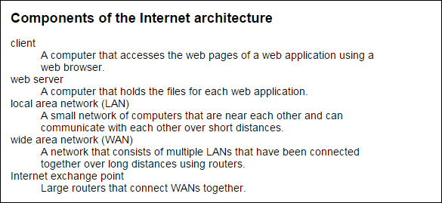
The description list in a web browser

Slide 12
Properties for formatting unordered lists
list-style-type
list-style-image
Values for the list-style-type property of an unordered list
disc
circle
square
none

Slide 13
HTML for two unordered lists
<h2>Popular web browsers include</h2>
<ul class="circle">
<li>Internet Explorer</li>
<li>Firefox</li>
<li>Chrome</li>
</ul>
<h2>Prime skills for web developers are</h2>
<ul class="star">
<li>HTML5 and CSS3</li>
<li>JavaScript</li>
<li>PHP</li>
</ul>
CSS that changes the bullets
ul.circle { list-style-type: circle; }
ul.star { list-style-image: url("../images/star.png"); }

Slide 14
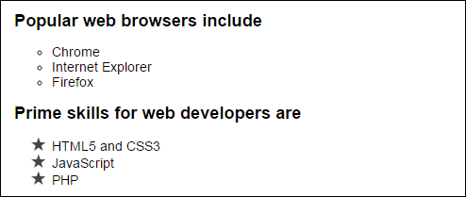
The bullet changes in a web browser

Slide 15
Common values for the list-style-type property of an ordered list
1. decimal
01. decimal-leading-zero
a. lower-alpha
A. upper-alpha
i. lower-roman
I. upper-roman

Slide 16
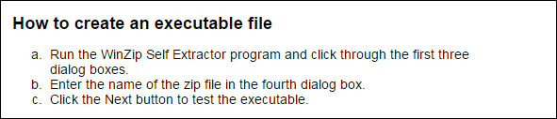
HTML for an ordered list
<h2>How to create an executable file</h2>
<ol class="lower_alpha">
<li>Run the WinZip Self Extractor program and click through the first three dialog boxes.</li>
<li>Enter the name of the zip file in the fourth dialog box.</li>
<li>Click the Next button to test the executable.</li>
</ol>
CSS that formats the list
ol.lower_alpha { list-style-type: lower-alpha; }

Slide 17
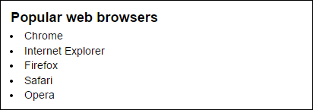
HTML for an unordered list
<h2>Popular web browsers</h2>
<ul>
<li>Chrome</li>
<li>Internet Explorer</li>
<li>Firefox</li>
<li>Safari</li>
<li>Opera</li>
</ul>
CSS that aligns the list items
h2, ul, li { margin: 0; padding: 0; }
ul { padding-left: 1em; }
li { padding-left: .25em; padding-bottom: .25em; }

Slide 18
Links
<a> tags

Slide 19
Common attributes for the <a> element
href
target
title
tabindex
accesskey
where the link takes you
which window/tab should the link open in
tooltip that appears when you hover the mouse
change the tab order
keyboard shortcut

Slide 20
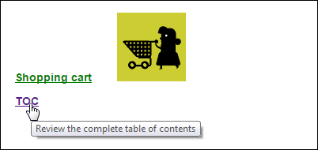
A text link, an image link, and a text link with a title attribute
<p>
<a href="/orders/cart.html"
accesskey="c" tabindex="0">Shopping cart</a>
<a href="/orders/cart.html"> <img src="images/cart_animated.gif"
alt="Shopping cart"></a>
</p>
<p><a href="/books/php_toc.html"
title="Review the complete table of contents"
>TOC</a></p>

Slide 21
Accessibility guidelines for links
The title attribute is used by screen-readers.
Tooltips do not work on touch screens.
If the text for a link has to be short, code the title attribute to clarify where the link is going.
You should also code the title attribute if a link includes an image/icon, but no text.

Slide 22
Common CSS pseudo-classes for formatting links
:link
:visited
:hover
:focus
:active
default state
links that have been visited
mouse is hovering over link
link has keyboard focus
mouse button is down, but not released

Slide 23
Properties for adding/removing underlines and borders
text-decoration
border-style

Slide 24

HTML
<ul>
<li><a href="toobin.html">Jeffrey Toobin</a></li>
<li><a href="sorkin.html">Andrew Ross Sorkin</a></li>
<li><a href="chua.html">Amy Chua</a></li>
</ul>
CSS
a:link {
text-decoration: underline;
color: green;
}
a:hover, a:focus, a:active {
text-decoration: none;
font-size: 125%;
}
Links in a browser with the focus on the third link

Slide 25
Accessibility guideline for :hover and :focus
Apply the same formatting for the :hover and :focus selectors.
That way, the formatting is the same whether you hover the mouse over a link or use the keyboard to tab to the link.

Slide 26
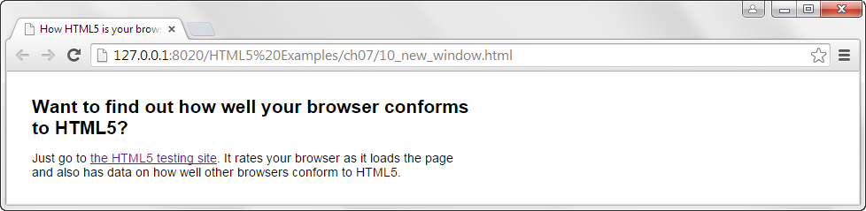
HTML for a link that loads the document in a new tab
<p>Just go to
<a href="http://www.html5test.com/" target="_blank">
the HTML5 testing site</a>. It rates your browser as it loads the page and also has data on how well other browsers conform to HTML5.
</p>

Slide 27
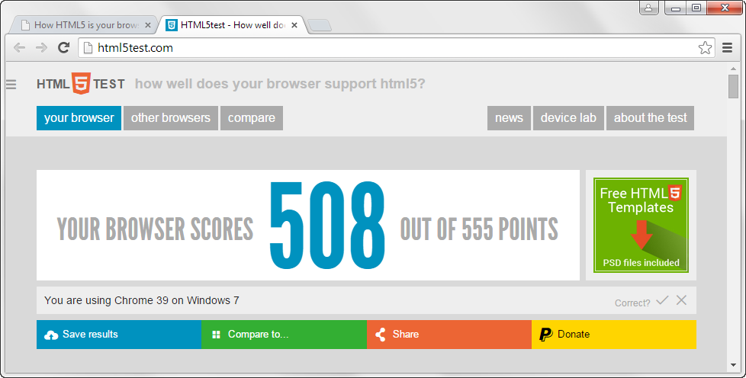
The html5test.com home page in another tab

Slide 28
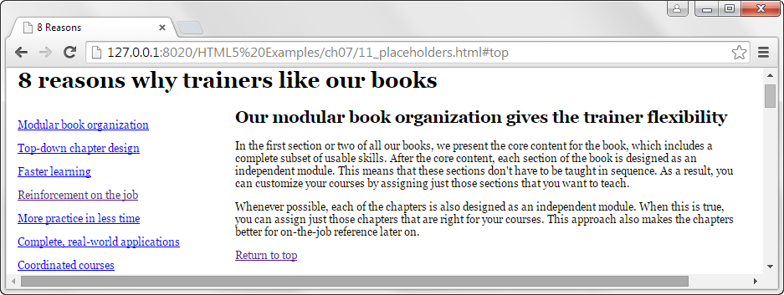
A web page that links to topics on the same page

Slide 29
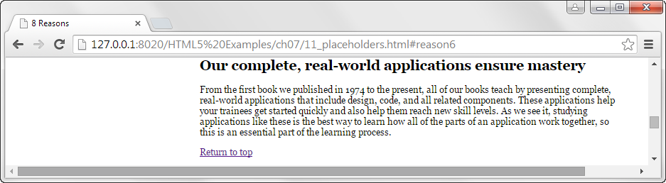
The page when the sixth link is clicked

Slide 30
Linking to placeholders on a page
The placeholder the top of the page
<h1><a id="top">8 reasons why trainers like our books</a></h1>
The placeholder for reason 6
<h2><a id="reason6">Our complete, real-world applications ensure mastery</a></h2>
Two links that jump to placeholders on the same page
<p><a href="#reason6">Complete, real-world applications</a></p>
<p><a href="#top">Return to top</a></p>
A link that jumps to a placeholder on this page from another page
<a href="8reasons.html#reason6">Complete, real-world applications</a>
Notes:
Can also use href="#" to point to the top of any page.

Slide 31
Links to Media Files
pdfs, audio, video

Slide 32
Some popular media formats
PDF
MP3
MP4
Portable Document Format / PostScript Document Format
compressed audio files
compressed video files

Slide 33
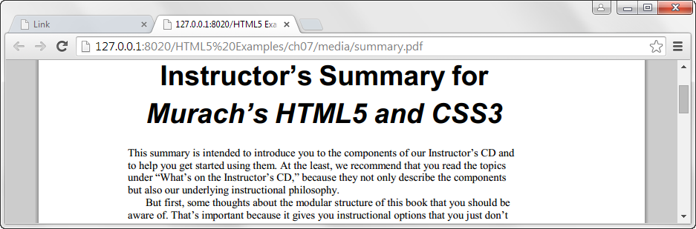
A link that opens a PDF file in a new tab
<a href="documents/instructors_summary.pdf"
type="application/pdf"
target="_blank">Read the Instructor's Summary<a>

Slide 34
An HTML link that plays an MP3 file
<a href="music/twist_away.mp3" type="audio/mpeg"> MP3 file</a>
An HTML link that plays a PowerPoint slide show
<a href="media/chapter_01.pps"
target="_blank">Review the slides for chapter 1</a>

Slide 35

A web page with links for email, phone, and Skype
Email, phone, and Skype links
A link that starts an email message
<a href="mailto:support@murach.com">Send us an email</a>
An email link with a CC address and a subject
<a href="mailto:support@murach.com?cc=ben@murach.com &subject=Web mail">Send us an email</a>
A link that calls a phone number
<a href="tel:555-555-5555">Call us</a>
A link that starts a Skype session
<a href="skype:murachsupport">Skype chat with us</a>

Slide 36
Navigation Menus
<nav>, <ul>, <li>, <a>

Slide 37
HTML5 Semantic <nav> tag
The <nav> tag should be used do delineate any Navigation Menu you create.
<nav>My links here...</nav>

Slide 38
CSS Display Property
display: block;
The element generates a block element box, generating line breaks both before and after the element when in the normal flow.
display: inline;
The element generates one or more inline element boxes that do not generate line breaks before or after themselves. In normal flow, the next element will be on the same line if there is space.
display: inline-block;
The element generates a block element box that will be flowed with surrounding content as if it were a single inline box.
display: none;
Turns off the display of an element so that it has no effect on layout (the document is rendered as though the element did not exist). All descendant elements also have their display turned off.
Examples: https://www.w3schools.com/cssref/pr_class_display.asp
Docs: https://developer.mozilla.org/en-US/docs/Web/CSS/display

Slide 39
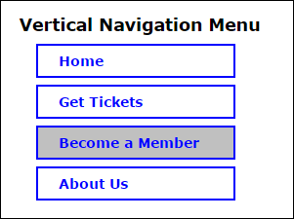
A vertical navigation menu
HTML
<nav id="nav_menu_1">
<ul>
<li><a href="index.html">Home</a></li>
<li><a href="tickets.html">Get Tickets</a></li>
<li><a href="members.html" class="current">Become a Member</a></li>
<li><a href="about_us.html">About Us</a></li>
</ul>
</nav>
book_examples/ch07/14_15_navigation.html

Slide 40
CSS for a vertical navigation menu
#nav_menu_1 ul {
list-style: none;
}
#nav_menu_1 ul li {
display: block;
width: 200px;
border: 2px solid blue;
}
#nav_menu_1 ul li a {
display: block;
color: blue;
text-decoration: none;
}
#nav_menu_1 ul li a.current {
background-color: silver;
}
book_examples/ch07/styles/navigation.css

Slide 41
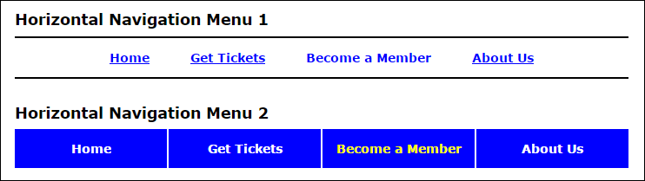
Two horizontal navigation menus
HTML
<nav id="nav_menu_2">
<ul>
<li><a href="index.html">Home</a></li>
<li><a href="tickets.html">Get Tickets</a></li>
<li><a href="members.html" class="current">Become a Member</a></li>
<li><a href="about_us.html" class="lastitem">About Us</a></li>
</ul>
</nav>
book_examples/ch07/14_15_navigation.html

Slide 42

The CSS for the first horizontal menu
#nav_menu_2 ul {
list-style: none;
text-align: center;
border-top: 2px solid black;
border-bottom: 2px solid black;
}
#nav_menu_2 ul li {
display: inline;
}
#nav_menu_2 ul li a {
color: blue;
text-decoration: underline;
}
#nav_menu_2 ul li a.current {
text-decoration: none;
}
book_examples/ch07/styles/navigation.css

Slide 43
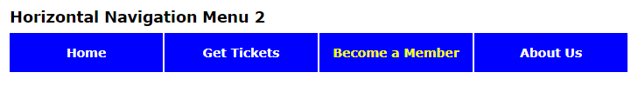
The CSS for the second horizontal menu
#nav_menu_3 ul { list-style: none; }
#nav_menu_3 ul li { display: block; float: left; }
#nav_menu_3 ul li a {
display: block;
width: 175px;
text-align: center;
text-decoration: none;
background-color: blue;
color: white;
border-right: 2px solid white;
}
#nav_menu_3 ul li:last-of-type a { border-right: none; }
#nav_menu ul li a.current { color: yellow; }
book_examples/ch07/styles/navigation.css

Slide 44
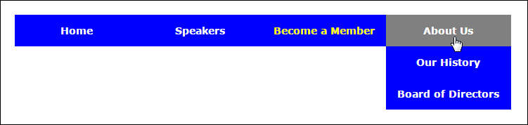
A 2-tier navigation menu
book_examples/ch07/16_navigation_2_tier.html

Slide 45
The HTML for the 2-tier menu
<nav id="nav_menu">
<ul>
<li><a href="index.html">Home</a></li>
<li>
<a href="#">Speakers</a>
<ul>
<li><a href="#">Jeffrey Toobin</a></li>
<li><a href="#">Andrew Ross Sorkin</a></li>
...
</ul>
</li>
<li><a href="members.html" class="current">Become a Member</a></li>
<li>
<a href="aboutus.html">About Us</a>
<ul>
<li><a href="#">Our History</a></li>
<li><a href="#">Board of Directors</a></li>
...
</ul>
</li>
</ul>
</nav>
book_examples/ch07/16_navigation_2_tier.html

Slide 46
The CSS for the 2-tier menu
#nav_menu ul {
list-style: none;
position: relative;
}
#nav_menu ul li { float: left; }
/* submenus */
#nav_menu ul ul {
display: none;
position: absolute;
top: 100%;
}
#nav_menu ul ul li { float: none; }
#nav_menu ul li:hover > ul,
#nav_menu ul li:focus-within > ul {
display: block;
}
/* clearfix */
#nav_menu > ul::after {
content: "";
display: block;
clear: both;
}
book_examples/ch07/styles/navigation_2_tier.css

Slide 47
The CSS for the 2-tier menu (continued)
#nav_menu_3 ul { list-style: none; }
#nav_menu_3 ul li { display: block; float: left; }
#nav_menu_3 ul li a {
display: block;
width: 175px;
text-align: center;
text-decoration: none;
background-color: blue;
color: white;
}
#nav_menu ul li a.current { color: yellow; }
#nav_menu ul li a:hover,
#nav_menu ul li a:focus {
color: white;
background-color: gray;
}
book_examples/ch07/styles/navigation_2_tier.css

Slide 48
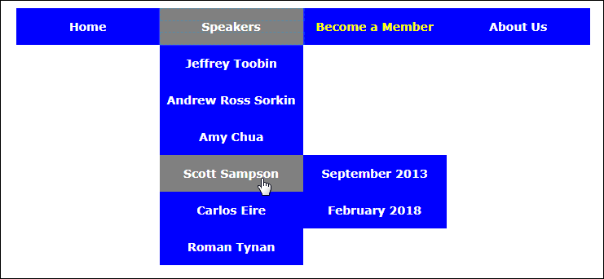
A 3-tier navigation menu
book_examples/ch07/17_18_navigation_3_tier.html

Slide 49
The HTML for the 3-tier menu
<nav id="nav_menu">
<ul>
<li><a href="index.html">Home</a></li>
<li><a href="speakers.html">Speakers</a>
<ul>
<li><a href="#">...</a></li>
<li><a href="#">...</a></li>
<li><a href="#">...Chua</a></li>
<li><a href="sampson.html">...</a>
<ul>
<li><a href="#">...</a></li>
<li><a href="#">...</a></li>
</ul>
</li>
<li><a href="#">...</a></li>
<li><a href="#">...</a></li>
</ul>
</li>
<li><a href="members.html">Become...</a></li>
book_examples/ch07/17_18_navigation_3_tier.html

Slide 50
The HTML for the 3-tier menu (continued)
<li><a href="aboutus.html">About Us</a>
<ul>
<li><a href="#">Our History</a></li>
<li><a href="#">Board...</a></li>
<li><a href="#">Past Speakers</a>
<ul>
<li><a href="#">2017</a></li>
<li><a href="#">2016</a></li>
<li><a href="#">2015</a></li>
</ul>
</li>
<li><a href="#"> Contact Information</a></li>
</ul>
</li>
</ul>
</nav>
book_examples/ch07/17_18_navigation_3_tier.html

Slide 51
The CSS for the operation of the 3-tier menu
/* the rest is the same as 2-tier navigation */
#nav_menu ul ul li {
float: none;
position: relative;
}
#nav_menu ul ul ul {
position: absolute;
left: 100%;
top: 0;
}
#nav_menu ul li:last-of-type ul ul {
left: -100%;
}
book_examples/ch07/styles/navigation_3_tier.css

Slide 52
Objectives
Applied
Use unordered lists and <a> elements to create navigation lists and navigation menus, including 2- and 3-tier menus.
Knowledge
Name and describe the three types of HTML lists.
Describe the use of <a> elements for linking to another web page, opening another web page in a new browser window, linking to placeholders on the same page, linking to media files, starting an email message, calling a phone number, or starting a Skype session.
Use these pseudo-classes for formatting links: :link, :visited, :hover, and :focus.
Use these CSS properties for formatting links: text-decoration or border.

